Slide 1
GE8151 Problem Solving and Python Programming
Rajasekaran S
Assistant Professor,
Department of Information Technology,
KGiSL Institute of Technology,
email: proffraja@gmail.com
Github:www.github.com/rajasekaranap

Slide 2
Functions
Functions is a set of codes that perform a defined operations.
It makes the program modular, reusable, readable.
Types of functions
Built in functions [comes with python library].
User defined functions [created by user].
Collection of functions makes modules

Slide 3
Functions
It is block of reusable code that performs specific task.
Provides Modularity and Reusability.
We can call anywhere, anytime in the program.
It also known as API’s.

Slide 4
Built in Functions [comes with python library]
Function | Description
abs() | Returns absolute value |N|
all() | Finds all the elements are true in a sequence
any() | Checks at least one element is true in a sequence
bin() | Converts Integer into Binary
int() | Converts string to integer
float() | Converts string to float
bool() | Converts the value to Boolean
chr() | Returns the ascii string of number passed
ord() | Returns the ascii value of character passed
dict() | Helps to create dictionary
hex() | Gives the hexadecimal representation of a number

Slide 5
Built in Functions [comes with python library]
Function | Description
input() | Returns the line of string
len() | Returns the length of objects [String, List, Tuple ... etc ]
list() | Creates and returns empty list
max() | Returns maximum value in sequence
min() | Returns minimum value in sequence
oct() | Converts to octal value from Integer
pow(x,y) | returns x to the power of y
round() | Rounds the float numbers to certain decimal points
slice() | Creates slice object specified by range
sorted() | It returns the sorted sequence
sum() | Returns sum of sequence
type() | Returns the type of element

Slide 6
User Defined Functions
User defined functions are created by the user.
It serves specific purpose to the user program.

Slide 7
Syntax for Creating Function
def function_name(argument_list):
Statement 1
Statement 2
.
.
.
Statement N

Slide 8
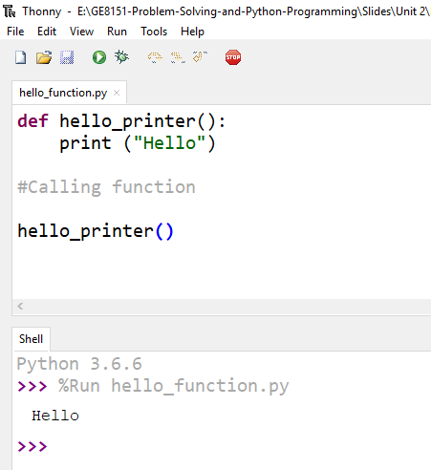
Hello World Function
keyword
Function Name
Argument List
Function Body
Calling Function

Slide 9
Task
Have to use only one print statement
Print hello for 5 time without loop
Loop the call for 5 times
Get n value and print no of hello’s

Slide 10
Thank You
Rajasekaran S
Assistant Professor,
Department of Information Technology,
KGiSL Institute of Technology,
email: proffraja@gmail.com
Github:www.github.com/rajasekaranap

